Slide 1
Operating Systems CS2006
Chapter:3
Inter-Process Communication (IPC)
Part:2

Slide 2
What’s in today’s lecture
Process Concept
Process Manager Responsibilities
Process Scheduling
Operations on Processes
Cooperating Processes
Inter-process Communication

Slide 3
Introduction
A process has access to the memory which constitutes its own address space.
When a child process is created, the only way to communicate between a parent and a child process is:
 The parent receives the exit status of the child
So far, we’ve discussed communication mechanisms only during process creation/termination
Processes may need to communicate during their life time.

Slide 4
Cooperating Processes
Independent process cannot affect or be affected by the execution of another process.
Cooperating process can affect or be affected by the execution of another process
Advantages of process cooperation
Information sharing
Computation speed-up
Modularity
Convenience
Dangers of process cooperation
Data corruption, deadlocks, increased complexity
Requires processes to synchronize their processing

Slide 5
Inter-Process Communication (IPC)
Mechanism for processes synchronize their actions.
Two main types
Shared Memory
Message Passing
to communicate and to

Slide 6








Communications Models
(a) Message passing. (b) shared memory.

Slide 7
Interprocess Communication – Shared Memory
An area of memory shared among the processes that wish to communicate
The communication is under the control of the users processes not the operating system.
Major issues is to provide mechanism that will allow the user processes to synchronize their actions when they access shared memory.
Synchronization is discussed in great details in Chapter 6.

Slide 8
Producer-Consumer Problem
Paradigm for cooperating processes, producer process produces information that is consumed by a consumer process
To allow producer and consumer processes to run concurrently, we must have available a buffer of items that can be filled by the producer and emptied by the consumer.
This buffer will reside in a region of memory that is shared by the producer and consumer processes.
A producer can produce one item while the consumer is consuming another item.
The producer and consumer must be synchronized, so that the consumer does not try to consume an item that has not yet been produced.

Slide 9
Producer-Consumer Problem
Two types of buffers can be used.
unbounded-buffer places no practical limit on the size of the buffer
bounded-buffer assumes that there is a fixed buffer size
 Let’s look more closely at how the bounded buffer illustrates inter- process communication using shared memory….

Slide 10
Bounded-Buffer – Shared-Memory Solution
The following variables reside in a region of memory shared by the producer and consumer processes:
Shared data
#define BUFFER_SIZE 10 typedef struct {
. . .
} item;
item buffer[BUFFER_SIZE]; int in = 0;
int out = 0;
Lets code this….

Slide 11
Bounded-Buffer – Producer
item next_produced; while (true) {
/* produce an item in next produced */ while (((in + 1) % BUFFER_SIZE) == out)
; /* buffer is full - do nothing */ buffer[in] = next_produced;
in = (in + 1) % BUFFER_SIZE;
}

Slide 12
Bounded Buffer – Consumer
item next_consumed; while (true) {
while (in == out)
; /* buffer empty - do nothing */ next_consumed = buffer[out];
out = (out + 1) % BUFFER_SIZE;
/* consume the item in next consumed */
}
■ This scheme allows at most BUFFER SIZE − 1 items in the buffer at the same time.

Slide 13
Message Passing (IPC)
Message system – processes communicate with each other without resorting to shared variables.
IPC facility provides two operations:
send(message) – message size fixed or variable
receive(message)
If P and Q wish to communicate, they need to:
establish a communication link between them
exchange messages via send/receive
Implementation of communication link
physical (i.e., shared memory, hardware bus)
logical (direct/indirect, blocking/non-blocking, automatic/ explicit buffering)

Slide 14
Implementation Questions
How are links established?
Can a link be associated with more than two processes?
How many links can there be between every pair of communicating processes?
What is the capacity of a link?
Is the size of a message that the link can accommodate fixed or variable?
Is a link unidirectional or bi-directional?

Slide 15
Message Passing Systems
Exchange messages over a communication link
Methods for implementing the communication link and primitives (send/receive):
Direct or Indirect communications (Naming)
Symmetric or Asymmetric communications (blocking versus non-blocking)
Buffering

Slide 16
Direct Communication
Processes must name each other explicitly:
send (P, message) – send a message to process P
receive(Q, message) – receive a message from process Q
Properties of communication link
Links are established automatically.
A link is associated with exactly one pair of communicating processes.
Between each pair there exists exactly one link.
Processes need to know each other’s identity
The link may be unidirectional, but is usually bi-directional.
Disadvantage: a process must know the name or ID of the process(es) it wishes to communicate with

Slide 17
Indirect Communication
Messages are directed and received from mailboxes (also referred to as ports).
Each mailbox has a unique id.
Processes can communicate only if they share a mailbox.
Properties of communication link
Link established only if processes have a shared mailbox
A link may be associated with many processes.
Each pair of processes may share several communication links.
Link may be unidirectional or bi-directional.

Slide 18
Indirect Communication (Cont.)
Operations provided by the OS
create a new mailbox
send and receive messages through mailbox
destroy a mailbox
Primitives are defined as:
send(A, message) – send a message to mailbox A
receive(A, message) – receive a message from mailbox A

Slide 19
Indirect Communication (Cont.)
Mailbox sharing
P1, P2, and P3 share mailbox A.
P1, sends; P2 and P3 receive.
Who gets the message?
Solutions
Allow a link to be associated with at most two processes.
Allow only one process at a time to execute a receive operation.
Allow the system to select arbitrarily the receiver. Sender is notified who the receiver was.

Slide 20
Synchronization
Message passing can be blocking or non-blocking
Four types of synchronization
Blocking send:
sender blocked until message received by mailbox or process
Nonblocking send:
sender resumes operation immediately after sending
Blocking receive:
receiver blocks until a message is available
Nonblocking receive:
receiver returns immediately with either a valid or null message.
20

Slide 21
Produces Consumer
■ Producer-consumer becomes trivial
The producer merely invokes the blocking
message next_produced;
while (true) {
send() call and waits
/* produce an item in next produced */ _{until the message is}
send(next_produced);
}
delivered to either the receiver or the mailbox.
message next_consumed; while (true) {
receive(next_consumed);
Likewise, when the consumer invokes receive(), it blocks until a message is available.
/* consume the item in next consumed */
}

Slide 22
Buffering
Messages exchanged by processes reside in temporary queue
Three ways to implement queues
Zero capacity
No messages may be queued within the link, requires sender to block until receiver retrieves message.
Bounded capacity
Link has finite number of message buffers. If no buffers are available then sender must block until one is freed up.
Unbounded capacity
Link has unlimited buffer space, consequently send never needs to block.

Slide 23
Communication in Client/Server Systems
Sockets
Remote procedure calls
Pipes
What types of Inter-Process Communication might each of these use?

Slide 24
1. Sockets
Defined as a point of communication
A pair of process communicating over a network employee a pair of sockets
Socket = IP Address : Port Number
All ports below 1024 are considered well known
FTP: 21
Telnet: 23
Web server: 80
24

Slide 25
Sockets
Client initiates a requests for connection, it is assigned a port by host computer
Connection on one host must be unique
Sockets can be
Connection-oriented (TCP) socket
Connectionless (UDP) socket
Considered Low level mode of communication
Shares unstructured stream of bytes

Slide 26
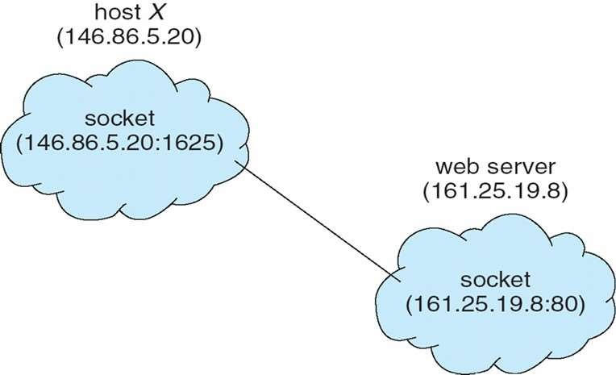
Sockets

Slide 27
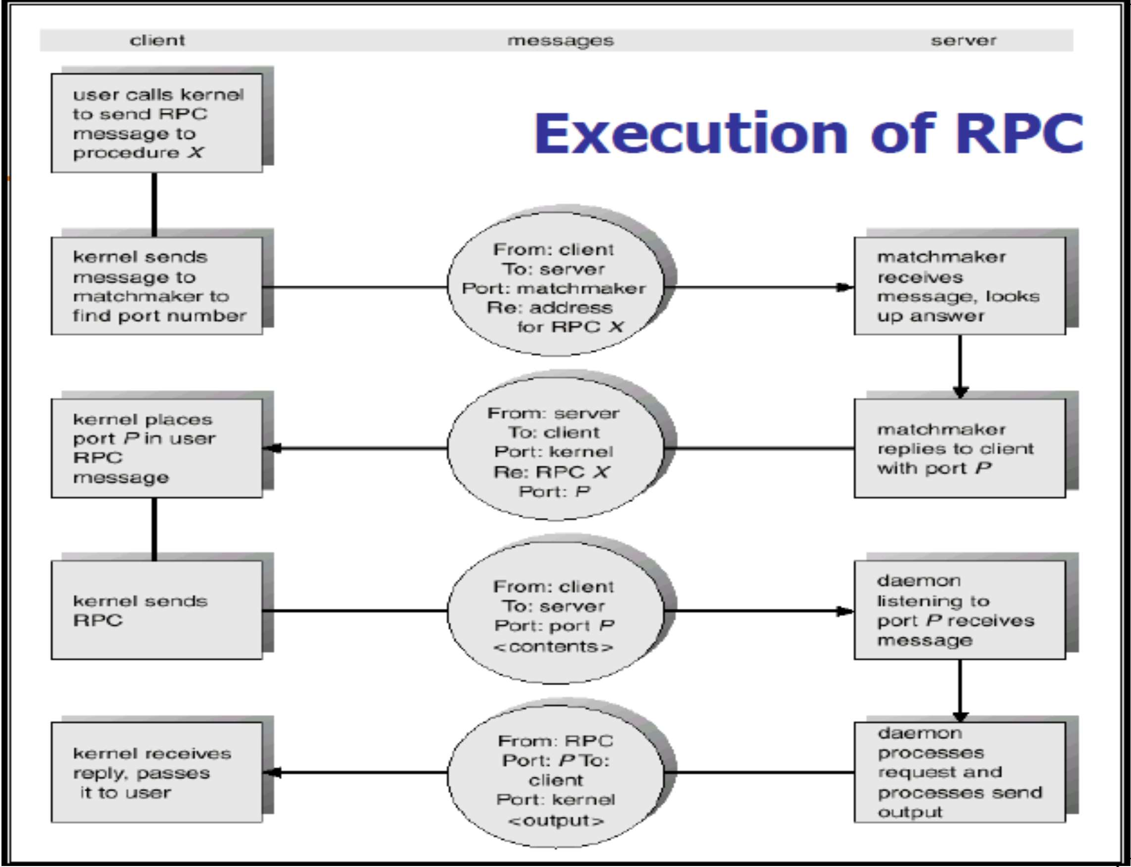
32
CS-2006 Operating Systems

Slide 28
3. Pipes
IPC mechanism in early UNIX systems
Four issues must be considered
Unidirectional or bi-directional communication
If bidirectional then is it half duplex or full duplex
Must a relationship (such as parent-child) exist between the communicating processes?
Can pipe communicate over a network?
33
CS-2006 Operating Systems

Slide 29
Pipes: Shared info in kernel’s memory
Buffer in kernel’s memory
fd[0]
fd[1]
Pipe
write()
read()
34

Slide 30
Pipe Creation (Unix)
#include <unistd.h>
int pipe(int filedes[2]);
Creates a pair of file descriptors pointing to a pipe inode
Places them in the array pointed to by filedes
filedes[0] is for reading
filedes[1] is for writing.
On success, zero is returned.
On error, -1 is returned
35

Slide 31
Pipe Creation
int main()
{ int pfds[2];
if (pipe(pfds) == -1)
{ perror("pipe"); exit(1); }
pfds[0]
pfds[1]
}
Process Kernel
Pipe flow of data
CS-2006 Operating Systems
36

Slide 32
Reading/Writing from/to a Pipe
 int read(int filedescriptor, char
*buffer, int bytetoread);
 int write(int filedescriptor,char
*buffer,int bytetowrite);
37
CS-2006 Operating Systems

Slide 33
Example
int main()
{ int pfds[2]; char buf[30];
if (pipe(pfds) == -1)
{
perror("pipe");
exit(1); }
printf("writing to file descriptor #%d\n", pfds[1]);
write(1, "test", 5);?
printf("reading from file descriptor #%d\n",pfds[0]);
read(pfds[0], buf, 5);
read(0, buf, 5);?
printf("read %s\n", buf);
}
write(pfds[1], "test", 5);

Slide 34
A Channel between two processes
Parent
Child
pfds[0]
pfds[1]
2. Fork()
pfds[0]
pfds[1]
1. Pipe()
Process
Kernel
Pipe flow of data

Slide 35
A Channel between two processes
To allow one way communication each process should close one end of the pipe.
Parent Child
2. Fork()
4. close(pfds[0]) pfds[0]
pfds[0]
pfds[1]
3. close(pfds[1])
pfds[1]
1. Pipe()
Process
Kernel
Pipe flow of data

Slide 36
An Example of pipes with fork
int main()
{
int pfds[2];
char buf[30]; pipe(pfds);…………………………………………1 if (fork()==0) ………………………………………2
{
close(pfds[0]);…………………………………3
printf(" CHILD: writing to the pipe\n");
write(pfds[1], "test", 5);
printf(" CHILD: exiting\n"); exit(0);
}
else {
close(pfds[1]);…………………………………………4
printf("PARENT: reading from pipe\n");
read(pfds[0], buf, 5);
printf( "PARENT: read \"%s\"\n", buf); wait(NULL);
}
} CS-2006 Operating Systems
41

Slide 37
Pipes
Two types of pipes
Ordinary pipes
Named pipes

Slide 38
Ordinary pipes
Ordinary pipes allow communication in standard producer-consumer form
Producer writes to one end of the pipe (the write-end)
Consumer reads from other end of the pipe (the read- end of the pipe)
Ordinary pipes are therefore unidirectional
Required parent-child relationship communicating processes
In windows known as Anonymous pipes
between

Slide 39
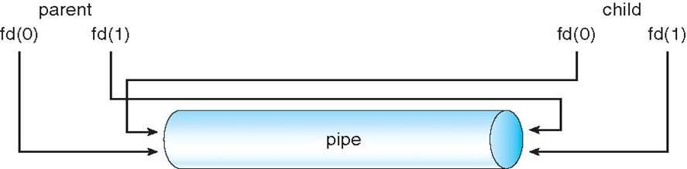
Ordinary pipe

Slide 40
Named pipes
Named pipes are more powerful than ordinary pipes
Communication is bidirectional
No parent-child relationship is necessary between the communicating processes
Several processes can use the named pipe for communication
Provided on both UNIX and Windows
Called FIFO in UNIX

Slide 41
References
 Operating System Concepts (Silberschatz, 9th edition) Chapter 3

